Slide 1
Introduction to ML and Linear Regression

Slide 2

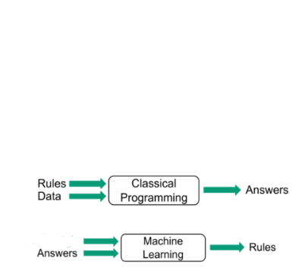
Introduction to Machine Learning
Data

Slide 3
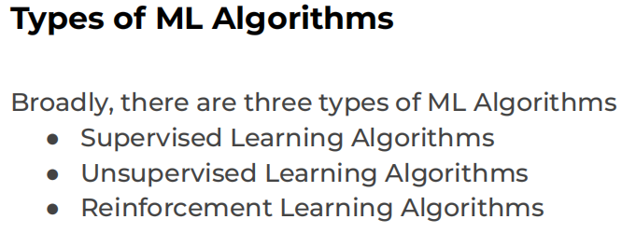
Machine learning algorithms are able to detect patterns in data and learn from them, in order to make their own predictions.

Slide 4
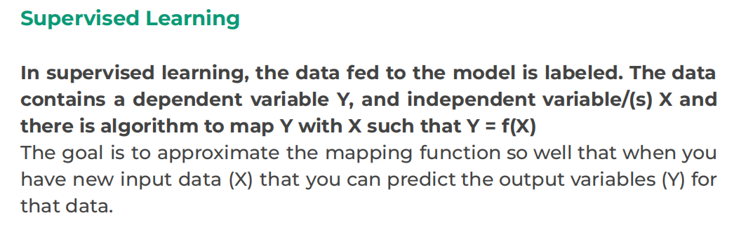
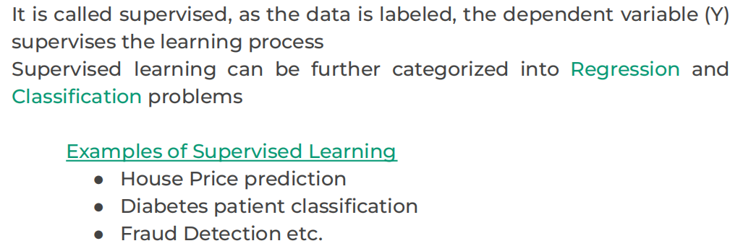

Slide 5
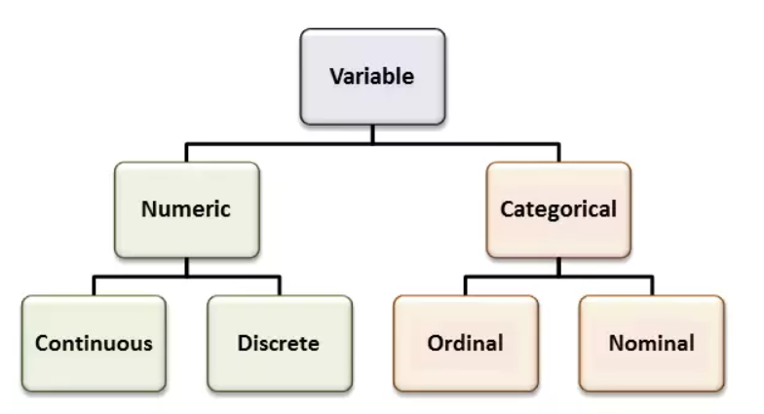
Variable Types
•Continuous- Can take any values between a permitted range. Examples- Height, Weight, Sales, Unemployment Rate
•Discrete- Can take a whole number value within a permitted range. Examples- number of cars owned by a family
•Ordinal- Logically ordered categorical values. Examples- Small, Medium, Large size T shirts
•Nominal- Not logically ordered categorical values. Example- Gender, Nationality, Religion, Language.

Slide 6
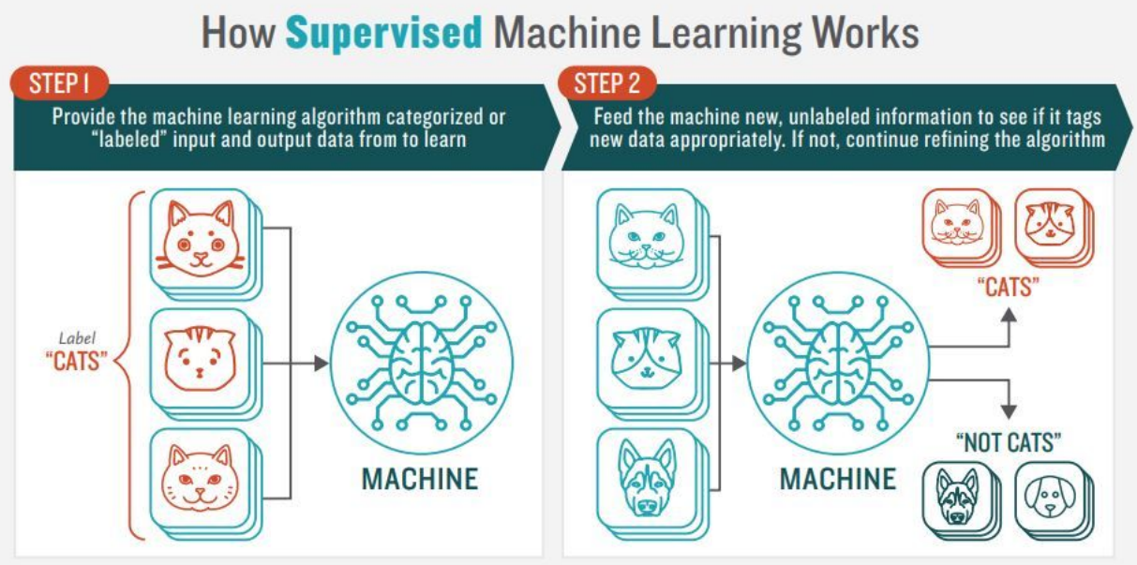

Slide 7
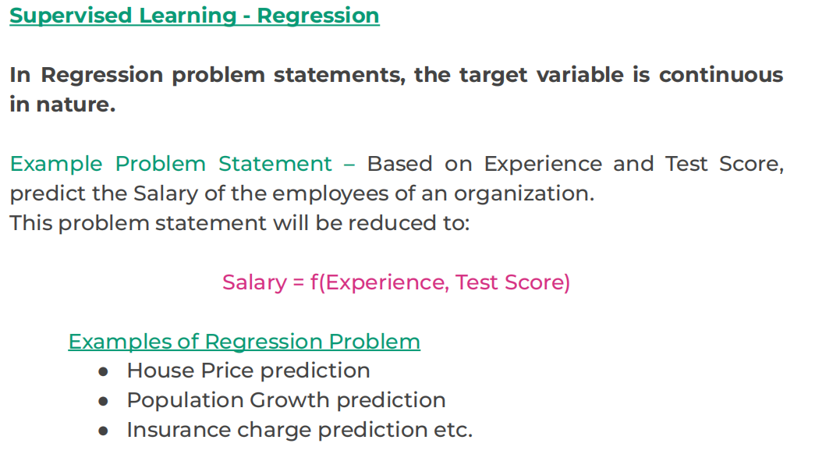

Slide 8
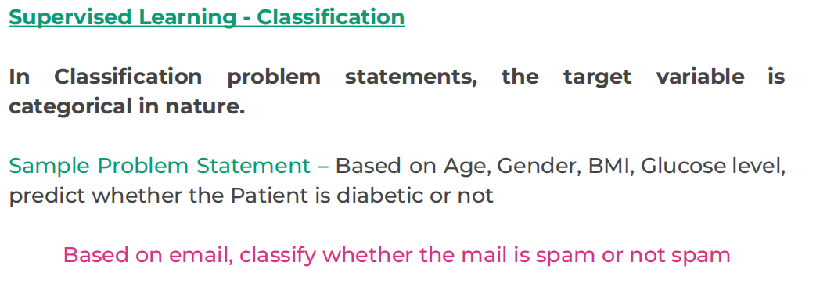
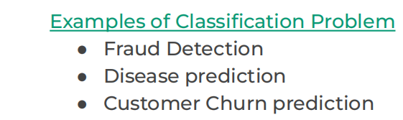

Slide 9
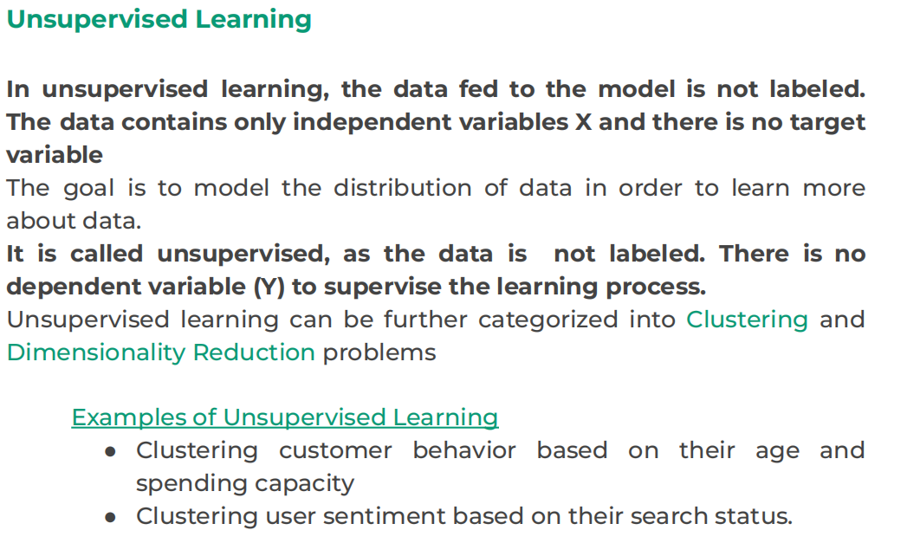

Slide 10
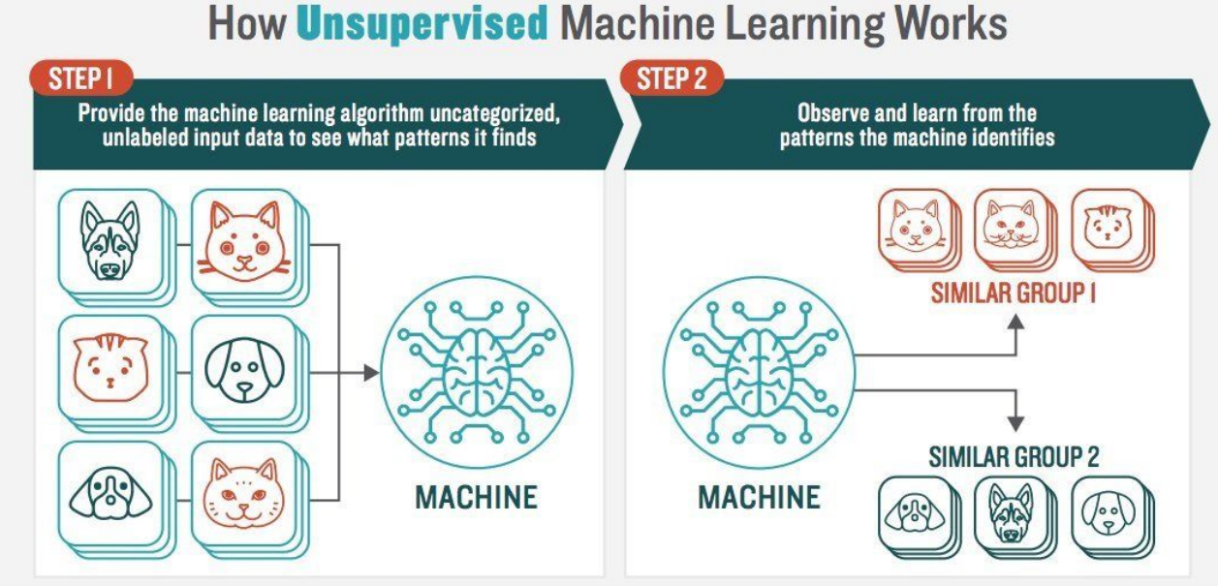

Slide 11
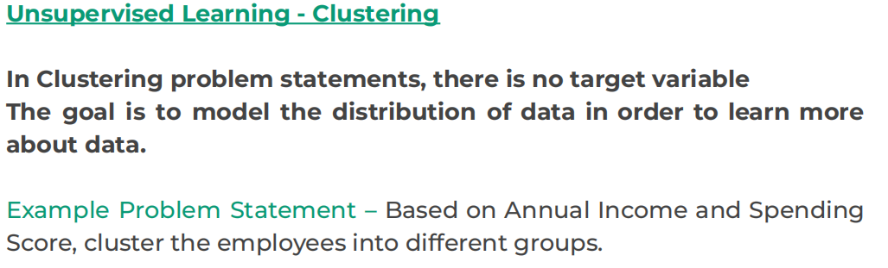
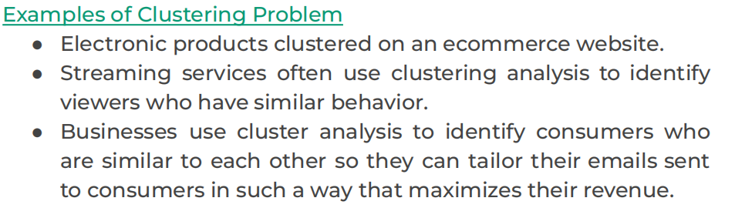

Slide 12
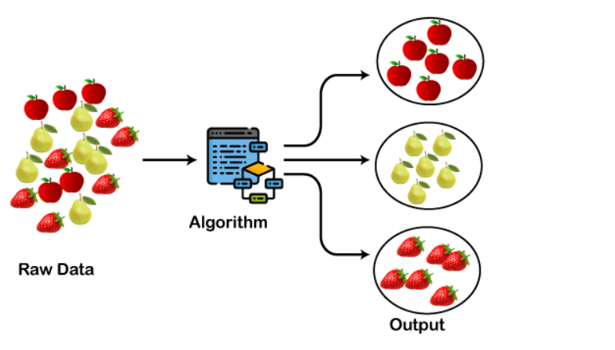
The below diagram explains the working of the clustering algorithm. We can see the different fruits are divided into several groups with similar properties.

Slide 13
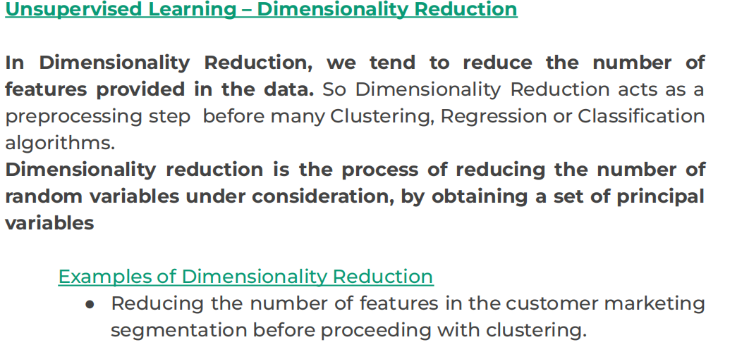
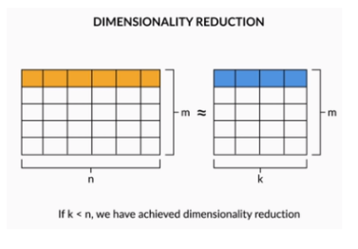
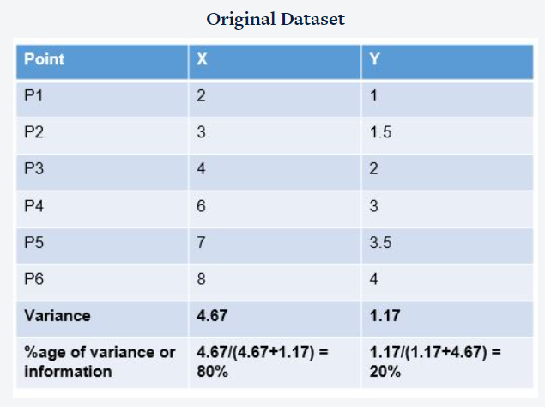
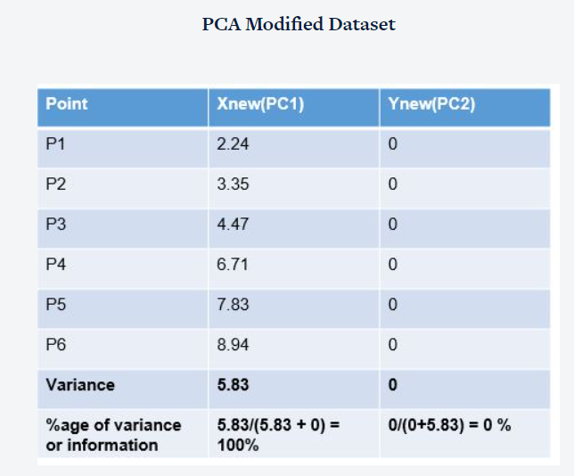

Slide 14
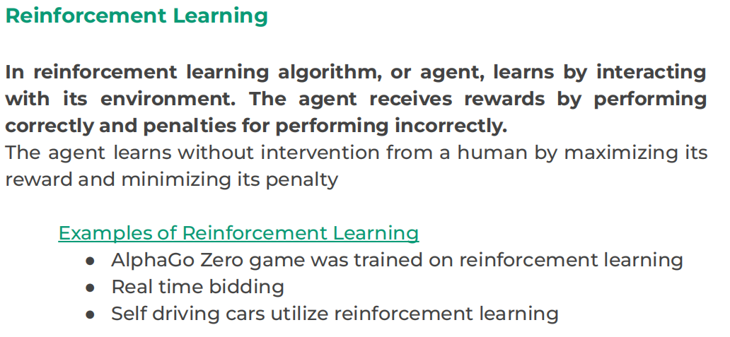
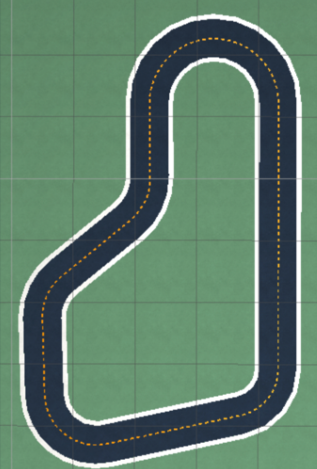

Slide 15
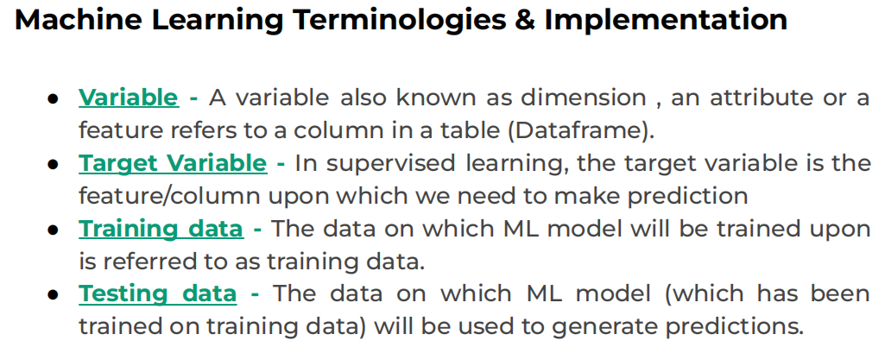

Slide 16
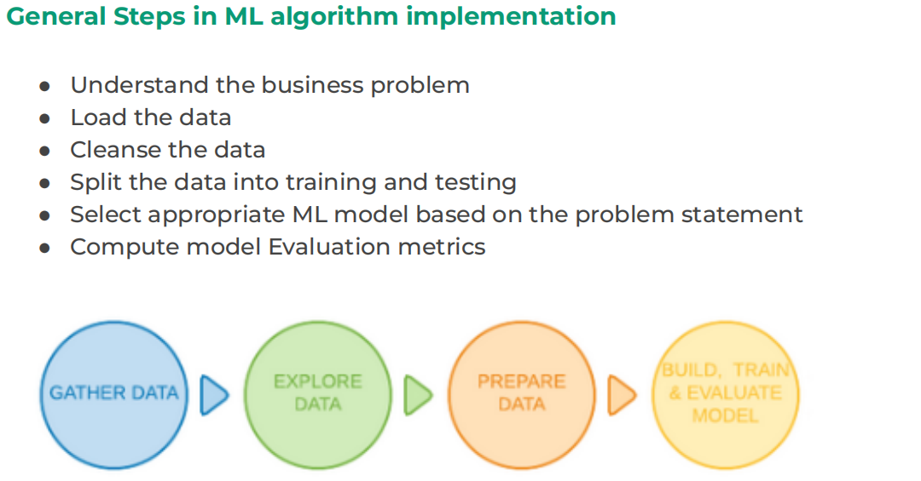

Slide 17
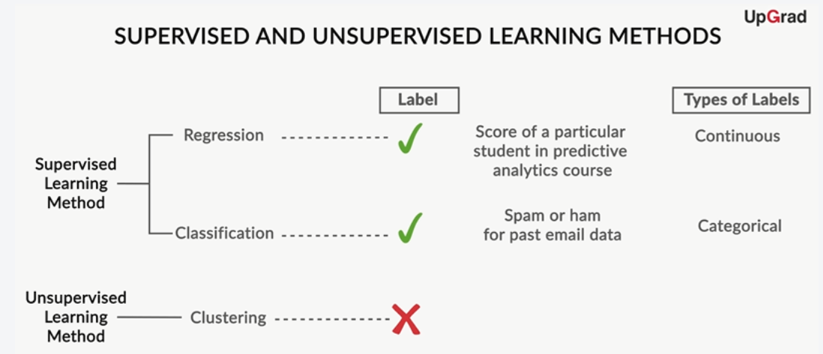
You can classify machine learning models into two broad categories:
Supervised learning methods
Past data with labels is used for building the model.
Regression and classification algorithms fall under this category.
Unsupervised learning methods
No predefined labels are assigned to past data.
Clustering algorithms fall under this category.

Slide 18
What Is Regression ?
Regression searches for relationships among variables. For example, you can observe several employees of some company and try to understand how their salaries depend on their features, such as experience,education level, role, city of employment, and so on.
The presumption is that the experience,education, role, and city are the independent features, while the salary depends on them.
You can try to establish the mathematical dependence of housing prices on area, number of bedrooms, distance to the city center, and so on.

Slide 19
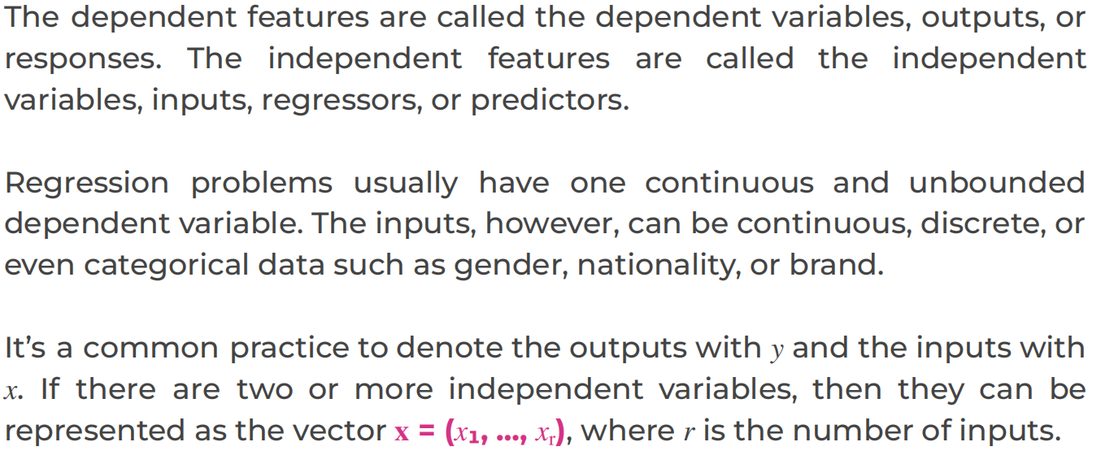

Slide 20
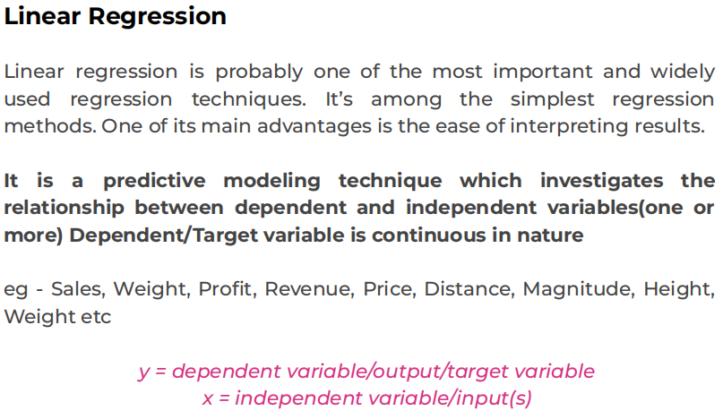

Slide 21
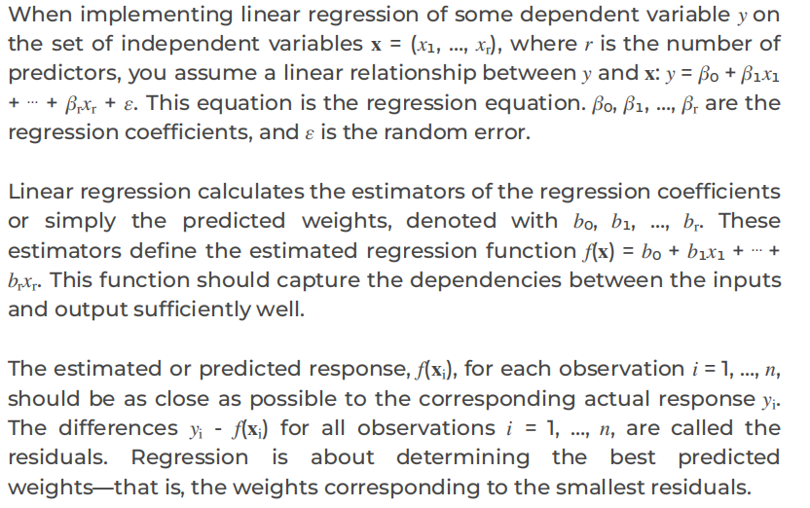
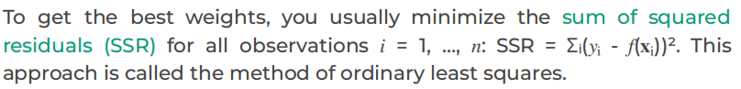

Slide 22

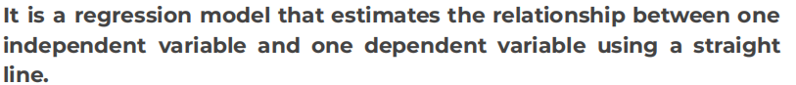
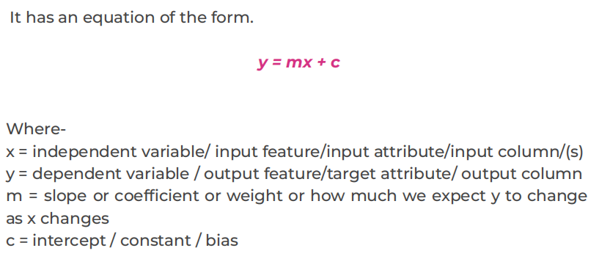

Slide 23
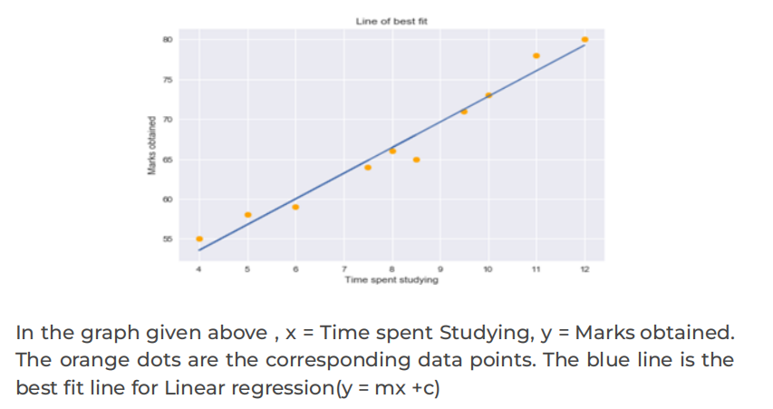

Slide 24
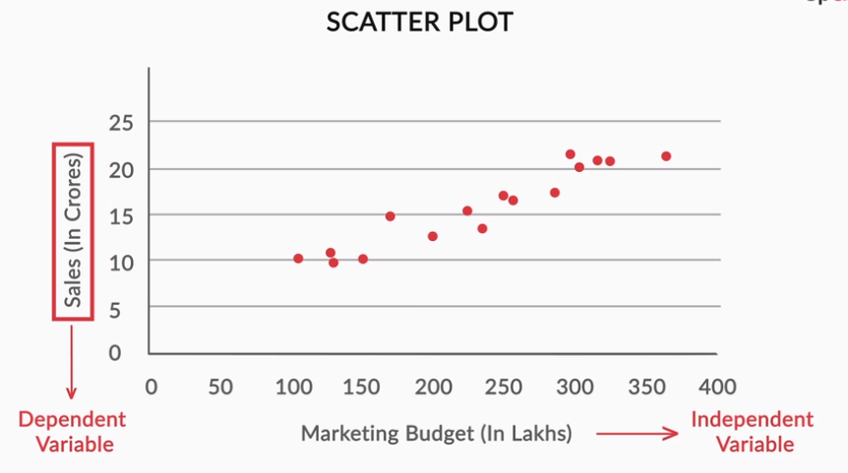
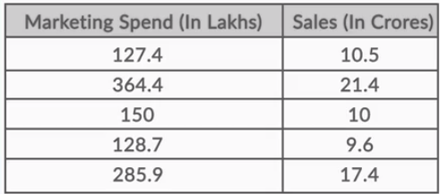
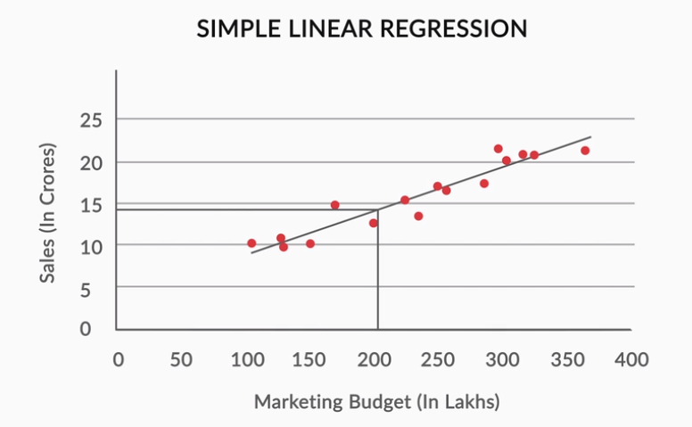
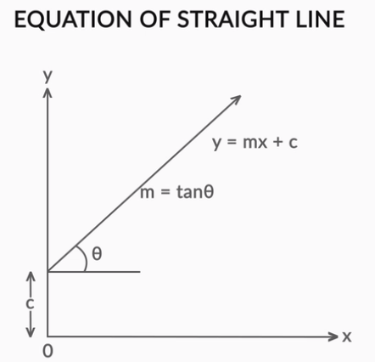
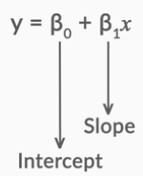
Regression Line

Slide 25
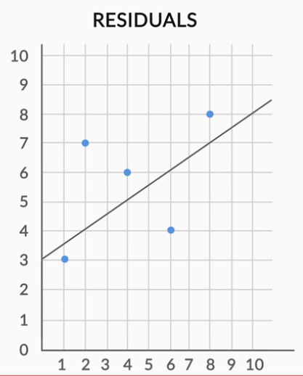
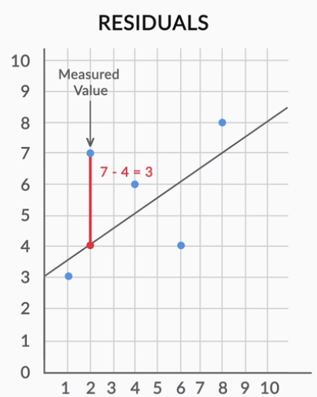
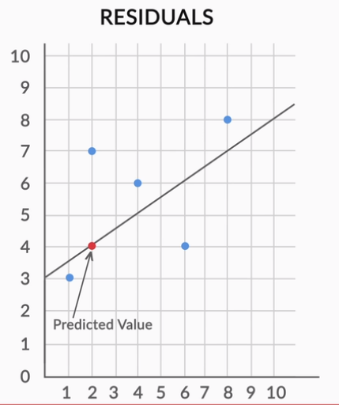
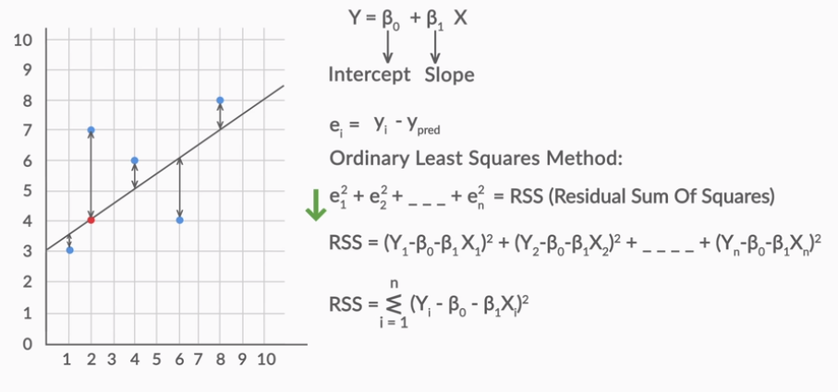
Residual for a point in the data is the difference between the actual value and the value predicted by our linear regression model.

Slide 26
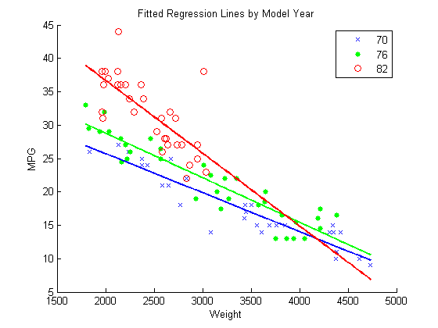
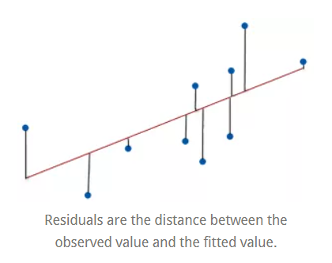
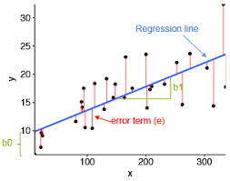
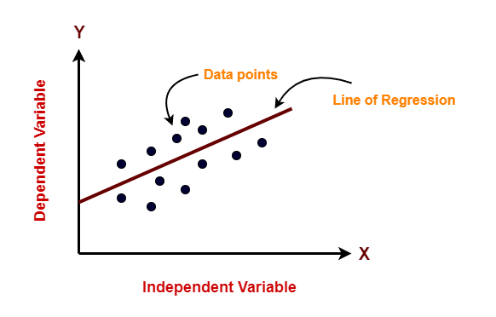

Slide 27
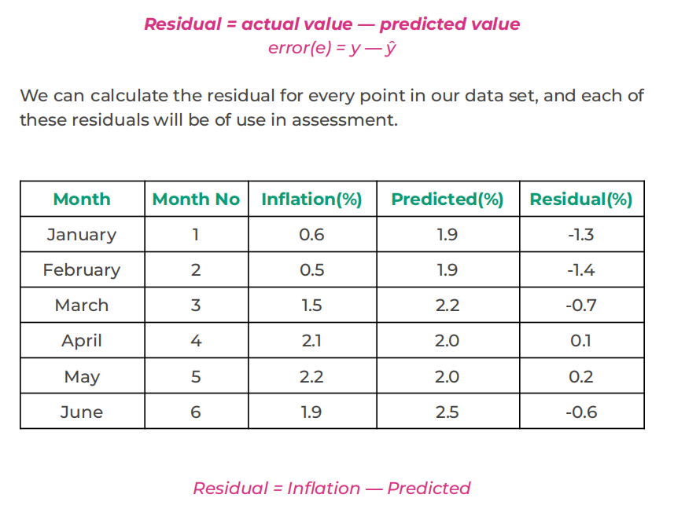
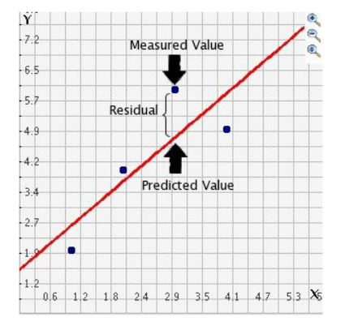

Slide 28
The lower the value of RSS, the better is the model predictions. Or we can say that – a regression line is a line of best fit if it minimizes the RSS value. But there is a flaw in this – RSS is a scale variant statistic. Since RSS is the sum of the squared difference between the actual and predicted value, the value depends on the scale of the target variable.
Residual Sum of Squares (RSS) - ∑([Actual(y) - Predicted(y))^2
Example:
Consider your target variable is the revenue generated by selling a product. The residuals would depend on the scale of this target. If the revenue scale was taken in “Hundreds of Rupees” (i.e. target would be 1, 2, 3, etc.) then we might get an RSS of about 0.54 (hypothetically speaking).
But if the revenue target variable was taken in “Rupees” (i.e. target would be 100, 200, 300, etc.), then we might get a larger RSS as 5400. Even though the data does not change, the value of RSS varies according to the scale of the target. This makes it difficult to judge what might be a good RSS value.
So, can we come up with a better statistic that is scale-invariant? This is where R-squared comes into the picture.

Slide 29
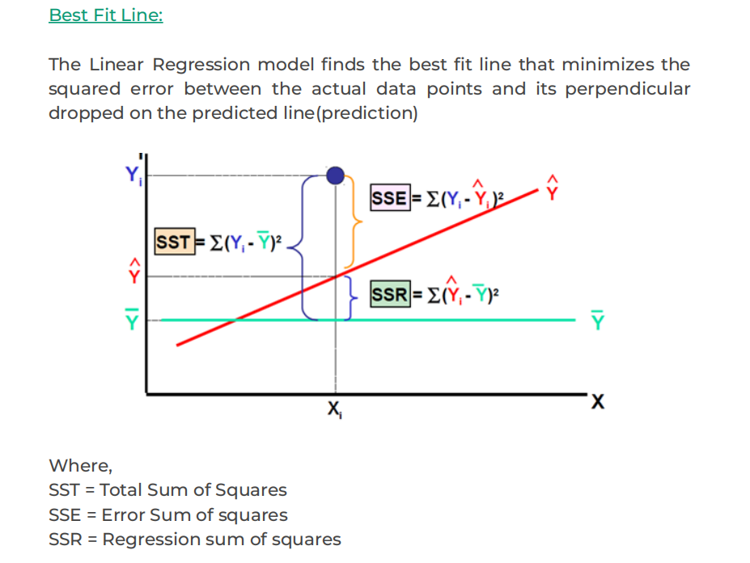
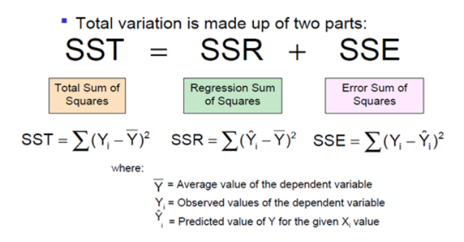

Slide 30
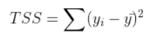
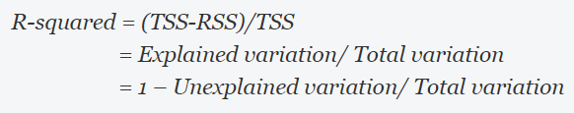
Total Sum of Squares :Total variation in target variable is the sum of squares of the difference between the actual values and their mean.While the variance is the average of the squared sums of difference between actual values and data points, TSS is the total of the squared sums.
RSS gives us the total square of the distance of actual points from the regression line. But if we focus on a single residual, we can say that it is the distance that is not captured by the regression line. Therefore, RSS as a whole gives us the variation in the target variable that is not explained by our model.
TSS gives us the total variation in Y, and RSS gives us the variation in Y not explained by X, then TSS-RSS gives us the variation in Y that is explained by our model. We can simply divide this value by TSS to get the proportion of variation in Y that is explained by the model. And this is our R-squared statistic
R-squared gives the degree of variability in the target variable that is explained by the model or the independent variables. If this value is 0.7, then it means that the independent variables explain 70% of the variation in the target variable.
R-squared value always lies between 0 and 1. A higher R-squared value indicates a higher amount of variability being explained by our model and vice-versa.

Slide 31
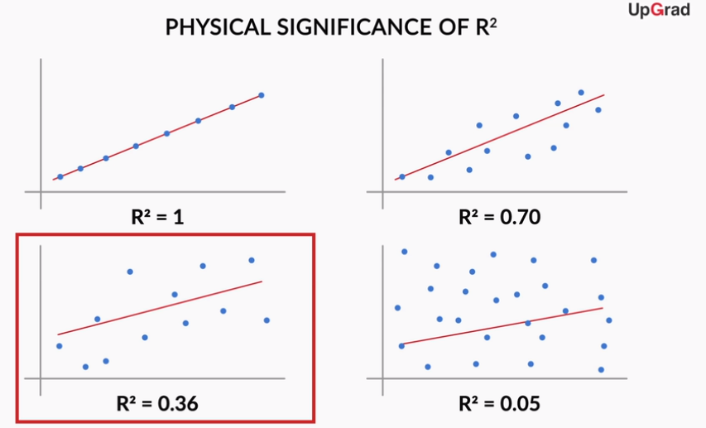
Strength of Simple Linear Regression
After determining the best fit line, there are a few critical questions that you need to answer, such as:
How well does the best fit line represent the scatter plot?
How well does the best fit line predict the new data?
R-squared statistic or coefficient of determination is a scale invariant statistic that gives the proportion of variation in target variable explained by the linear regression model.
R² (Percent of Variation Explained) metric tells us the amount of variance explained by the independent variables in the model.R2 varies between zero (no linear relationship) and one (perfect linear relationship).
R2 , officially known as the coefficient of determination.
The R-squared statistic isn’t perfect. In fact, it suffers from a major flaw. Its value never decreases no matter the number of variables we add to our regression model. That is, even if we are adding redundant variables to the data, the value of R-squared does not decrease. It either remains the same or increases with the addition of new independent variables. This clearly does not make sense because some of the independent variables might not be useful in determining the target variable. Adjusted R-squared deals with this issue.

Slide 32



Adjusted R-squared statistic
The Adjusted R-squared takes into account the number of independent variables used for predicting the target variable. In doing so, we can determine whether adding new variables to the model actually increases the model fit.
Let’s have a look at the formula for adjusted R-squared to better understand its working.
Here,
n represents the number of data points in our dataset
k represents the number of independent variables, and
R represents the R-squared values determined by the model
if R-squared does not increase significantly on the addition of a new independent variable, then the value of Adjusted R-squared will actually decrease.
On the other hand, if on adding the new independent variable we see a significant increase in R-squared value, then the Adjusted R-squared value will also increase

Slide 33
What are the assumptions made in regression ?
As we discussed above, regression is a parametric technique, so it makes assumptions. Let's look at the assumptions it makes:
There exists a linear and additive relationship between dependent (DV) and independent variables (IV). By linear, it means that the change in DV by 1 unit change in IV is constant. By additive, it refers to the effect of X on Y is independent of other variables.
There must be no correlation among independent variables. Presence of correlation in independent variables lead to Multicollinearity. If variables are correlated, it becomes extremely difficult for the model to determine the true effect of IVs on DV.
The error terms must possess constant variance. Absence of constant variance leads to heteroskedestacity.
The error terms must be uncorrelated i.e. error at ∈t must not indicate the error at ∈t+1. Presence of correlation in error terms is known as Autocorrelation. It drastically affects the regression coefficients and standard error values since they are based on the assumption of uncorrelated error terms.
The dependent variable and the error terms must possess a normal distribution.
Presence of these assumptions make regression quite restrictive. By restrictive I meant, the performance of a regression model is conditioned on fulfillment of these assumptions.

Slide 34


There is a linear relationship between X and Y:
Error terms are normally distributed with mean zero(not X, Y):
X and Y should display some sort of a linear relationship; otherwise, there is no use of fitting a linear model between them
There is no problem if the error terms are not normally distributed if you just wish to fit a line and not make any further interpretations.
One particular repercussion of the error terms not being normally distributed is that the p-values obtained during the hypothesis test to determine the significance of the coefficients become unreliable.

Slide 35


Error terms are independent of each other
Error terms have constant variance (homoscedasticity)
The error terms should not be dependent on one another
The variance should not increase (or decrease) as the error values change.
Also, the variance should not follow any pattern as the error terms change.

Slide 36


Constant Variance :
It means that when you plot the individual error against the predicted value, the variance of the error predicted value should be constant. See the red arrows in the picture below, the length of the red lines (a proxy of its variance) are the same.

Slide 37


How do I know these assumptions are violated in my data?
Residual (Vertical distance between a data point and the regression line) vs. Fitted Values Plot (Fitted values are also called predicted values)
Ideally, this plot shouldn't show any pattern. But if you see any shape (curve, U shape), it suggests non-linearity in the data set. In addition, if you see a funnel shape pattern, it suggests your data is suffering from heteroskedasticity, i.e. the error terms have non-constant variance.
Normality Q-Q Plot
As the name suggests, this plot is used to determine the normal distribution of errors. It uses standardized values of residuals. Ideally, this plot should show a straight line. If you find a curved, distorted line, then your residuals have a non-normal distribution (problematic situation).

Slide 38

Scale Location Plot
Scale-Location plot shows whether residuals are spread equally along the ranges of input variables (predictor). The assumption of equal variance (homoscedasticity) could also be checked with this plot. If we see a horizontal line with randomly spread points, it means that the model is good.
The plot is between fitted values and the square root of standardized residuals. The top plot shows the linear function, and the residuals are spread randomly along the horizontal lines, whereas in the bottom plot, there seems to be a pattern that is not random. Hence, the variance is not equal
Presence of a pattern determine heteroskedasticity. Don't forget to corroborate the findings of this plot with the funnel shape in residual vs. fitted values.

Slide 39


Hypothesis Testing in Linear Regression
When you fit a straight line through the data, you'll obviously get the two parameters of the straight line, i.e. the intercept (β0) and the slope (β1). Now, while β0 is not of much importance right now, but there are a few aspects surrounding β1 which need to be checked and verified.
The first question we ask is, "Is the beta coefficient significant?" What does this mean?
Suppose you have a dataset for which the scatter plot looks like the following
If you run a linear regression on this dataset in Python, it will fit a line on the data
Now, you can clearly see that the data in randomly scattered and doesn't seem to follow a linear trend or any trend, in general. But Python will anyway fit a line through the data using the least squares method. But you can see that the fitted line is of no use in this case

Slide 40

Every time you perform a linear regression, you need to test whether the fitted line is a significant one or not or to simply put it, you need to test whether β1 is significant or not. And in comes the idea of Hypothesis Testing on β1.
If you fail to reject the null hypothesis that would mean that β1 is zero which would simply mean that β1 is insignificant and of no use in the model. Similarly, if you reject the null hypothesis, it would mean that β1 is not zero and the line fitted is a significant one
If the p-value turns out to be less than 0.05, you can reject the null hypothesis and state that β1 is indeed significant.

Slide 41

F-statistic is similar in the sense that now instead of testing the significance of each of the betas, it tells you whether the overall model fit is significant or not.
If the 'Prob (F-statistic)' is less than 0.05, you can conclude that the overall model fit is significant. If it is greater than 0.05, you might need to review your model as the fit might be by chance

Slide 42


Slide 43



Slide 44



Slide 45


Multicollinearity

Slide 46


Two basic ways of dealing with multicollinearity:
Looking at pairwise correlations
Looking at the correlation between different pairs of independent variables
Checking the variance inflation factor (VIF)
Sometimes, pairwise correlations are not enough.
Instead of just one variable, the independent variable may depend upon a combination of other variables.
VIF calculates how well one independent variable is explained by all the other independent variables combined.
The VIF is given by:
Quiz: will VIF for a variable change if you drop one of the other predictor variables?

Slide 47



Dealing with Categorical Variables

Slide 48



Scaling just affects the coefficients and none of the other parameters, such as t-statistic, F-statistic, p-values and R-squared
Model Assessment and Comparison
n is the sample size, meaning the number of rows you would have in the data set, and
p is the number of predictor variables.

Slide 49


Slide 50
If you are a non-graphical person, you can also perform quick tests / methods to check assumption violations:
Durbin Watson Statistic (DW) - This test is used to check autocorrelation. Its value lies between 0 and 4. A DW=2 value shows no autocorrelation. However, a value between 0 < DW < 2 implies positive autocorrelation, while 2 < DW < 4 implies negative autocorrelation.
Variance Inflation Factor (VIF) - This metric is used to check multicollinearity. VIF <=4 implies no multicollinearity but VIF >=10 suggests high multicollinearity. Alternatively, you can also look at the tolerance (1/VIF) value to determine correlation in IVs. In addition, you can also create a correlation matrix to determine collinear variables.
Breusch-Pagan / Cook Weisberg Test - This test is used to determine presence of heteroskedasticity. If you find p < 0.05, you reject the null hypothesis and infer that heteroskedasticity is present.
How can you improve the accuracy of a regression model ?
There is little you can do when your data violates regression assumptions. An obvious solution is to use tree-based algorithms which capture non-linearity quite well. But if you are adamant at using regression, following are some tips you can implement:
If your data is suffering from non-linearity, transform the IVs using sqrt, log, square, etc.
If your data is suffering from heteroskedasticity, transform the DV using sqrt, log, square, etc. Also, you can use weighted least square method to tackle this problem.
If your data is suffering from multicollinearity, use a correlation matrix to check correlated variables. Let's say variables A and B are highly correlated. Now, instead of removing one of them, use this approach: Find the average correlation of A and B with the rest of the variables. Whichever variable has the higher average in comparison with other variables, remove it. Alternatively, you can use penalized regression methods such as lasso, ridge, elastic net, etc.
You can do variable selection based on p values. If a variable shows p value > 0.05, we can remove that variable from model since at p> 0.05, we'll always fail to reject null hypothesis.

Slide 51
How can you access the fit of regression model?
R Square (Coefficient of Determination) - As explained above, this metric explains the percentage of variance explained by covariates in the model. It ranges between 0 and 1. Usually, higher values are desirable but it rests on the data quality and domain. For example, if the data is noisy, you'd be happy to accept a model at low R² values. But it's a good practice to consider adjusted R² than R² to determine model fit.
Adjusted R²- The problem with R² is that it keeps on increasing as you increase the number of variables, regardless of the fact that the new variable is actually adding new information to the model. To overcome that, we use adjusted R² which doesn't increase (stays same or decrease) unless the newly added variable is truly useful.
F Statistics - It evaluates the overall significance of the model. It is the ratio of explained variance by the model by unexplained variance. It compares the full model with an intercept only (no predictors) model. Its value can range between zero and any arbitrary large number. Naturally, higher the F statistics, better the model.
RMSE / MSE / MAE - Error metric is the crucial evaluation number we must check. Since all these are errors, lower the number, better the model. Let's look at them one by one:
MSE - This is mean squared error. It tends to amplify the impact of outliers on the model's accuracy. For example, suppose the actual y is 10 and predictive y is 30, the resultant MSE would be (30-10)² = 400.
MAE - This is mean absolute error. It is robust against the effect of outliers. Using the previous example, the resultant MAE would be (30-10) = 20
RMSE - This is root mean square error. It is interpreted as how far on an average, the residuals are from zero. It nullifies squared effect of MSE by square root and provides the result in original units as data. Here, the resultant RMSE would be √(30-10)² = 20. Don't get baffled when you see the same value of MAE and RMSE. Usually, we calculate these numbers after summing overall values (actual - predicted) from the data.

Slide 52
Linear Regression : Interview Questions
1. What are the assumptions of linear regression?
2. Assume that you have made predictions using Linear Regression, when would you be sure that the predictions made can be acceptable?
3. What do you understand by R2-score? When are r-squared and adjusted r-squared the same?
4. Does a weak Pearson’s correlation coefficient always imply that the variable are not correlated?
5. What are some common drawbacks of the linear regression model? What are some ways to overcome them?
6. What is multicollinearity? How do you identify and deal with multicollinearity in your dataset?
7. How does RFE work? Recursive Feature Elimination
8. Explain the working of gradient descent.
9. What is heteroscedasticity? What are the consequences, and how can you overcome it?
10. How do you interpret a linear regression model?
11. How is hypothesis testing used in linear regression?
12. What is the difference between Regression and ANOVA?

